Slide 1

Medical Named Entity Recognition from Biomedical literature
19/07/2024
Submitted by: Under the guidance of :
Sona Rosa Babloo Dr. Jeena Kleenankandy
80521018 Assistant Professor
Department of Computer Science

Slide 2
Introduction
Medical NER involves the detection and labeling of medically relevant terms such as diseases, treatments, genes, and proteins within scientific texts.
It classifies these entities into predefined categories, enhancing the organization and analysis of biomedical information.
This process is vital for various biomedical research applications, including information retrieval, knowledge extraction, and text mining.
NER systems automate the categorization of named entities, streamlining the processing of large volumes of text.
The range of entities recognized includes diseases (e.g., cancer), treatments (e.g., chemotherapy), genes (e.g., BRCA1), proteins (e.g., insulin), and anatomical terms (e.g., heart).

Slide 3
For example:
Input text:
"In unanesthetized, spontaneously hypertensive rats, the decrease in blood pressure and heart rate produced by intravenous clonidine, 5 to 20 micrograms/kg, was inhibited or reversed by naloxone, 0."
Corresponding NER tags:
['O', 'O', 'O', 'O', 'B-Disease', 'O', 'O', 'O', 'O', 'O', 'O', 'O', 'O', 'O', 'O', 'O', 'O', 'B-Chemical', 'O', 'O', 'O', 'O', 'O', 'O', 'O', 'O', 'O', 'O', 'O', 'O', 'B-Chemical', 'O', 'O', 'O']
0: “O” (Other)
1: “B-Chemical” (Beginning of Chemical entity)
2: “B-Disease” (Beginning of Disease entity)
Sourced from BC5BDR Dataset

Slide 4
Problem Statement
To develop an advanced Medical Named Entity Recognition system capable of accurately identifying and classifying chemical and disease entities within biomedical literature, as well as determining the existence and nature of causal relationships between these entities.

Slide 5
Objective
To accurately identify and classify mentions of chemical entities (e.g., drugs, compounds) and disease entities (e.g., medical conditions, disorders) within biomedical literature.
Method: Employ a fine-tuned BERT model to process the text and output entity labels corresponding to each token. The model will recognize entities such as “aspirin” (chemical) and “hypertension” (disease) and tag them appropriately.

Slide 6
Objective
2. To determine the existence and nature of any causal relationships
between the identified chemical and disease entities within the text.
Method: Utilizing the BERT model to analyze pairs of entities and classify whether a chemical-induced disease relationship exists. For instance, the model should be able to infer from context whether “aspirin” is used to treat “hypertension.”
Example:
Input Text: “Aspirin, commonly used to reduce fever, may also lower the risk of hypertension.”
NER Output: “[Aspirin]_Chemical, commonly used to reduce [fever]_Disease, may also lower the risk of [hypertension]_Disease.”
RE Output: “Aspirin → reduces → fever”, “Aspirin → lowers risk → hypertension”

Slide 7
Dataset
BC5BDR Dataset :
BC5CDR corpus was developed for the BioCreative V challenge.
Purpose: The BC5CDR corpus was created to support disease named entity recognition (DNER) and chemical-induced disease (CID) relation extraction tasks.
Content: It contains 1500 PubMed articles with annotations for 4409 chemicals, 5818 diseases, and 3116 chemical-disease interactions.
Annotation Process: Annotations were done by Medical Subject Headings (MeSH) indexers and Comparative Toxicogenomics Database (CTD) curators, with high inter-annotator agreement scores.
Utility: The corpus is intended to be a valuable resource for biomedical text-mining research, particularly for advancing the state-of-the-art in extraction of CDRs.
To access the dataset : https://huggingface.co/datasets/tner/bc5cdr

Slide 8
Related Works
RECENT ADVANCEMENTS RELATED THIS DATASET: 1. Biomedical Named Entity Recognition using BERT in the Machine Reading Comprehension
Framework:
Authors: Cong Sun, Zhihao Yang, Lei Wang, Yin Zhang, Hongfei Lin, Jian Wang.
Summary:
Instead of treating BioNER as a sequence labeling problem, this paper formulates it as a machine reading comprehension (MRC) problem.
This formulation can introduce more prior knowledge utilizing well-designed queries and eliminates the need for decoding processes such as conditional random fields (CRF).
Conducted experiments on six BioNER datasets: BC4CHEMD, BC5CDR-Chem, BC5CDR-Disease, NCBI-Disease, BC2GM, and JNLPBA.

Slide 9
Related Works
RECENT ADVANCEMENTS RELATED THIS DATASET: 1. Biomedical Named Entity Recognition using BERT in the Machine Reading Comprehension
Achieved state-of-the-art (SOTA) performance with the following F1-scores:
BC4CHEMD: 92.92%
BC5CDR-Chem: 94.19%
BC5CDR-Disease: 87.83%
NCBI-Disease: 90.04%
BC2GM: 85.48%
JNLPBA: 78.93%

Slide 10
Literature Review
Jiao Li, Yueping Sun and Robin J. Johnson et al. BioCreative V CDR task corpus: a resource for chemical disease relation extraction. Database: The Journal of Biological Databases and Curation. 2016. Vol. 2016. DOI: 10.1093/database/baw068
The method for named entity recognition (NER) mentioned in the paper is performed using manual annotation supported by automated tools such as PubTator , DNorm etc.
To ensure accuracy, the entities were first captured independently by two annotators followed by a consensus annotation: The average scores were 87.49% and 96.05% for the disease and chemicals, respectively.

Slide 11
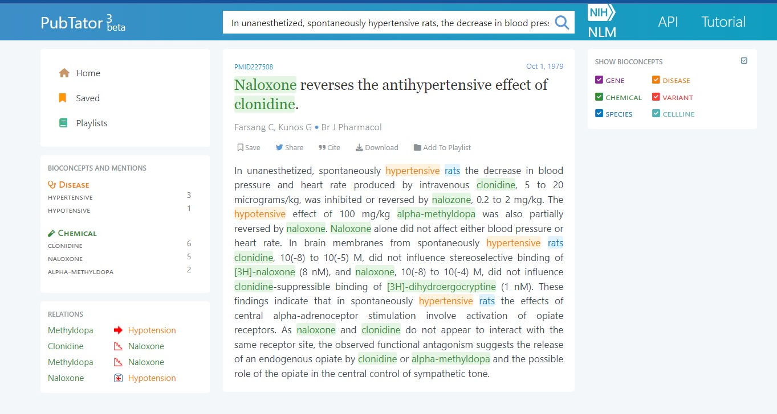
Research paper insights
PubTator 3

Slide 12
Limitations
Scalability: Manual annotation is time-consuming and labor-intensive.
Cost: Manual annotation involves hiring skilled annotators, which can be expensive.
Difficulty in Handling Large Text Corpora: Manual annotation becomes increasingly challenging when dealing with large text corpora, such as biomedical literature.
Time-Intensive Iterative Process: Manual annotation often involves iterative cycles of annotation, review, and refinement to improve accuracy and consistency.
.

Slide 13
Limitations
Data Dependency: NER models often require large amounts of annotated training data. Obtaining such data can be costly and time-consuming
Entity Ambiguity:Can struggle with entities that have multiple meanings or are used in different contexts across various domains
Entity Variation: The variation in how entities are expressed, including abbreviations, acronyms, and alternative names, poses a challenge for consistent entity recognition
.

Slide 14
Objective
To accurately identify and classify mentions of chemical entities (e.g., drugs, compounds) and disease entities (e.g., medical conditions, disorders) within biomedical literature.
Method: Employ a fine-tuned BERT model to process the text and output entity labels corresponding to each token. The model will recognize entities such as “aspirin” (chemical) and “hypertension” (disease) and tag them appropriately.

Slide 15
Objective
2. To determine the existence and nature of any causal relationships
between the identified chemical and disease entities within the text.
Method: Utilizing the BERT model to analyze pairs of entities and classify whether a chemical-induced disease relationship exists. For instance, the model should be able to infer from context whether “aspirin” is used to treat “hypertension.”
Example:
Input Text: “Aspirin, commonly used to reduce fever, may also lower the risk of hypertension.”
NER Output: “[Aspirin]_Chemical, commonly used to reduce [fever]_Disease, may also lower the risk of [hypertension]_Disease.”
RE Output: “Aspirin → reduces → fever”, “Aspirin → lowers risk → hypertension”

Slide 16
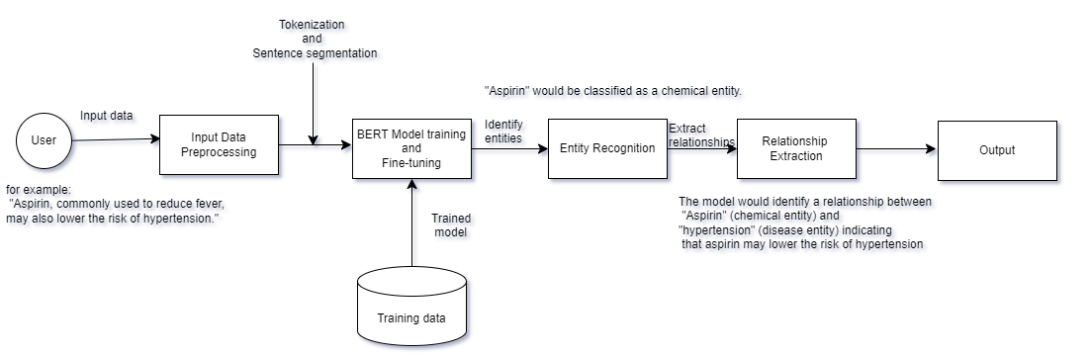
Architecture

Slide 17
Methodology
Libraries and Frameworks
Pandas:
Used for data manipulation and analysis.
In this project, it is used to read and process the CONLL format data files.
urllib:
Used for downloading data files from the internet.
Pathlib:
Provides an object-oriented interface to the file system paths.
SimpleTransformers:
A high-level library built on top of Hugging Face’s Transformers library.
Used for training and fine-tuning BERT models for Named Entity Recognition (NER).
Transformers:
A library from Hugging Face that provides general-purpose architectures like BERT, GPT, etc., for natural language processing tasks.
Logging:
Python’s built-in logging library is used to track events that happen during the execution of the program.

Slide 18
Methodology
Preprocessing Tools
Tokenization and Sentence Segmentation:
Essential for preparing text data for the BERT model.
Tokenization: Splits the text into individual tokens (words or subwords).
Sentence Segmentation: Divides the text into sentences.
Model Training
BERT Pre-trained Model:
Specifically, the 'bert-base-uncased' model is used for entity recognition tasks.
NERModel from SimpleTransformers:
Facilitates the creation, training, and evaluation of NER models using BERT.
Evaluation Tools
Evaluation Metrics:
The model’s performance is evaluated using metrics like the accuracy score.

Slide 19
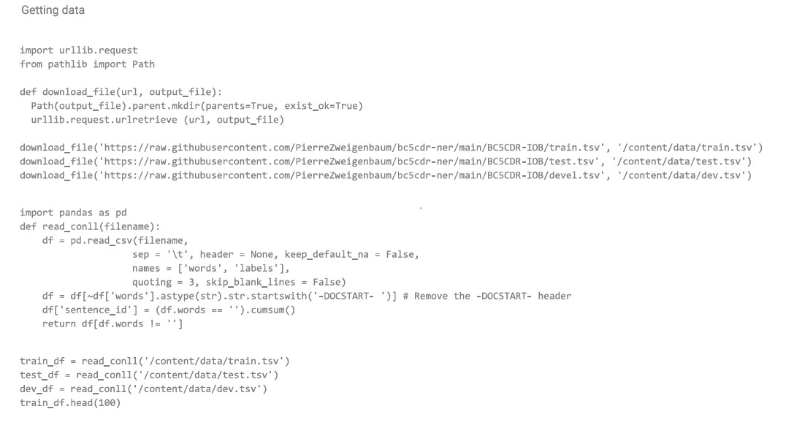
Results
2. Results - Data Preprocessing

Slide 20
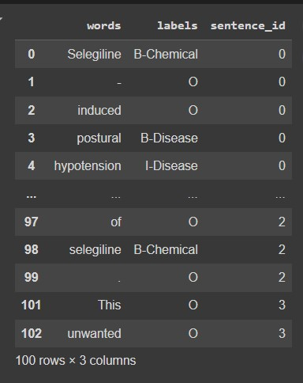
Results
2. Results - Data Preprocessing :Output

Slide 21
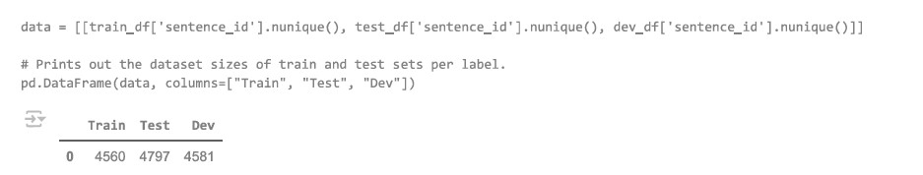
Results
2. Results - Output :Data split

Slide 22
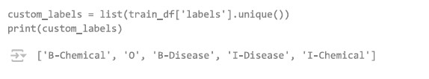
Results
2. Results - Output
3. Labels
4. Using the model to run inference

Slide 23
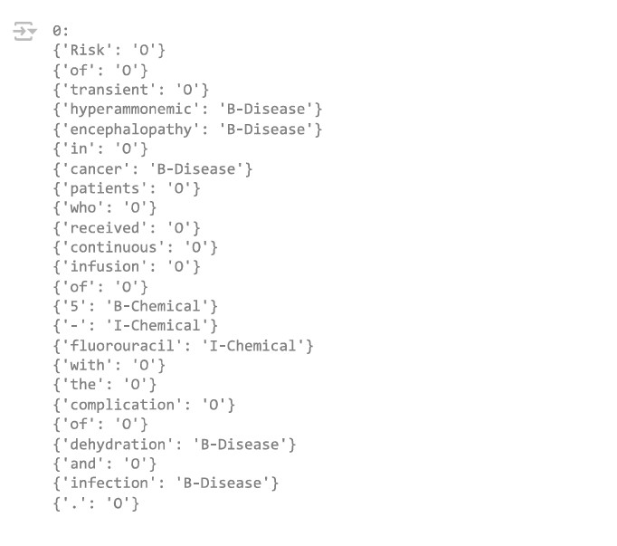
Results
4. Results :Using the model to run inference : NER

Slide 24
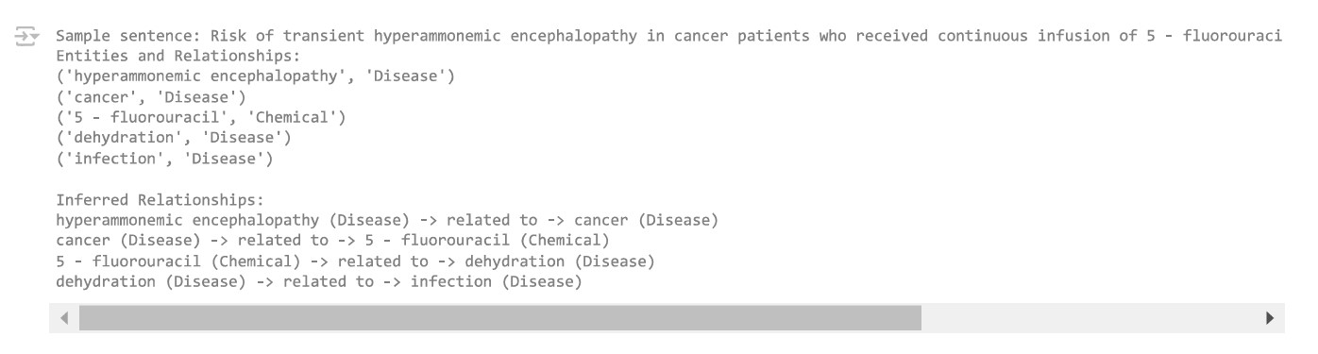
Results
2. Results - RE: Relation Extraction

Slide 25
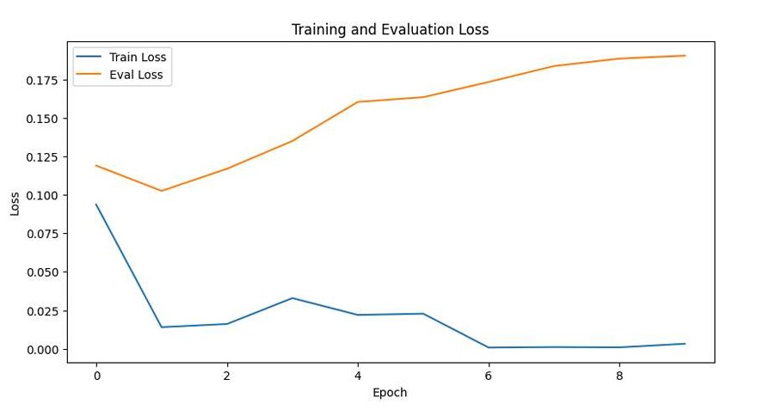
Results
2. Results:- Plot of Training vs Evaluation plot

Slide 26
Results
Results - Model Evaluation
Evaluation Metrics
{'eval_loss': 0.19666091880450645, 'precision': 0.8083916083916084, 'recall': 0.8458241873105466,'f1_score': 0.8266843745211216}

Slide 27
Conclusion
Interpretation:
The model's precision and recall values indicate high performance.
Effectively identifies and classifies entities.
Balanced performance across different classes, showing robustness.
Challenges and Limitations
Handling Noisy Data:
Noisy data in the CONLL files required careful preprocessing.
Computational Constraints:
Limited computational resources restricted the ability to experiment with larger models or extensive hyperparameter tuning.
Entity Ambiguity:
Multiple names and abbreviations for the same entity can lead to misclassification.

Slide 28
Conclusion
Future Work and Improvements
Larger and More Diverse Dataset:
Use a larger and more diverse dataset to improve model generalization.
Experimentation with Different Models:
Experiment with different NER models and architectures to find the most effective one.
Enhanced Preprocessing:
Enhance preprocessing steps to better handle noisy data.
Sophisticated Relationship Extraction:
Implement more sophisticated relationship extraction techniques to capture complex relationships between entities using relation data.

Slide 29
References
Amogh Kamat Tarcar, Aashis Tiwari, Dattaraj Rao, Vineet Naique Dhaimodker, Penjo Rebelo and Rahul Desai. (2020). “Healthcare NER Models Using Language Model Pretraining: Empirical Evaluation of Healthcare NER Model Performance with Limited Training Data.” In Proceedings of Health Search and Data Mining Workshop (HSDM 2020) in the 13th ACM International WSDM Conference (WSDM 2020). ACM, Houston, TX, USA. https://doi.org/10.1145/3336191.3371879
Dhananjay Ashok, Zachary C. Lipton.(2023).”PromptNER: Prompting For Named Entity Recognition”.ArXiv. https://doi.org/10.48550/arXiv.2305.15444
Chen, Yuxuan, Jonas Mikkelsen, Arne Binder, Christoph Alt and Leonhard Hennig. “A Comparative Study of Pre-trained Encoders for Low-Resource Named Entity Recognition.” ArXiv abs/2204.04980 (2022): n. pag.

Slide 30
Thank You

